Slide 1
PROFESSOR VELAZQUEZ
INTRODUCTION
TO
MICROECONOMICS
MODULE 07 · STRUCTURAL INEQUALITY & GAME THEORY PREVIEW
FALL 2025

Slide 2
07
Structural Inequality Core
& Game Theory Preview
Module 6 ended by observing that the competitive model takes the distribution as given. This module removes that assumption. Section I builds four mechanisms that produce unequal outcomes from identical markets. Section II previews the strategic reasoning Module 11 formalizes.
MODULE

Slide 3
MODULE 7 · ASYNCHRONOUS 📹
Agenda, Big Questions & Opening Inquiry
BIG QUESTIONS
PRE-WORK
WHAT YOU'LL NEED
(1) Why do poverty traps persist even in growing economies — and what mechanisms sustain them?
(2) How does market power in labor markets (monopsony) explain wages below VMP — and who designs the institutions that allow it?
(3) What is game theory, and why do rational individual strategies sometimes produce collectively irrational outcomes?
· Review Module 5 (VMP, monopsony preview) and Module 6 (poverty traps, Kuznets)
· Complete the Module 7 Vocabulary Checklist
· Read Akerlof (1970), 'The Market for Lemons' — the abstract and Section I
· Bring the Module 7 Worksheet and graph paper
ASYNC FORMAT: watch each Part's recorded segment, pause, and complete the corresponding activities.
· Module 7 Worksheet (printed)
· Calculator for the Gini computation
· Graph paper for the Lorenz curve and the monopsony diagram
· Your Module 2 notes on the bandwidth tax
OPENING INQUIRY
Marcus earns $15/hr. Ray earns rent, interest and profit. Both are participating in the same market — yet their outcomes diverge sharply. CAN OUR MODELS EXPLAIN WHY? Or do they require structural extensions?
SECTION I — POVERTY, INEQUALITY & LABOR MARKET DISTORTIONS | SECTION II — STRATEGIC INTERACTION
Part 1 · The poverty trap and its feedback mechanisms Part 2 · The Lorenz Curve and the Gini Coefficient Part 3 · Monopsony, statistical discrimination and VMP divergence Part 4 · Principal-agent problems: moral hazard and adverse selection | Part 5 · Game theory preview: dominant strategies, Nash equilibrium, and the collective action problem The formal treatment — mixed strategies, repeated games, the folk theorem — arrives in Module 11.
INTRO TO MICROECONOMICS | PROF. VELAZQUEZ
MODULE 7: STRUCTURAL INEQUALITY & GAME THEORY PREVIEW

Slide 4
BEFORE WE BEGIN
Vocabulary Checklist — Module 7
Poverty Trap
Lorenz Curve
Gini Coefficient
Intergenerational Mobility
Credit Desert
Monopsony
Marginal Factor Cost (MFC)
Average Cost of Labor (ACL)
Wage Discrimination
Statistical Discrimination
Principal-Agent Problem
Information Asymmetry
Moral Hazard
Adverse Selection
Market for Lemons
Game Theory (preview)
Payoff Matrix
Dominant Strategy
Nash Equilibrium
Prisoner's Dilemma
Collective Action Problem
Public Goods
Free Rider
Pareto-Superior Outcome
Bandwidth Tax (Module 2)
THE ORGANIZING CLAIM OF THIS MODULE
Every mechanism in Section I produces a wage BELOW VMP, or an outcome below the efficient one, WITHOUT any party behaving irrationally. Inequality here is not a story about effort or preference. It is a story about STRUCTURE — and structures are designed.
INTRO TO MICROECONOMICS | PROF. VELAZQUEZ
MODULE 7: STRUCTURAL INEQUALITY & GAME THEORY PREVIEW

Slide 5
SECTION I
Poverty, Inequality & Labor Market Distortions
Part 1 · The poverty trap: a self-reinforcing structural equilibrium
Part 2 · Measuring the distribution: the Lorenz Curve and the Gini Coefficient
Part 3 · Monopsony wage suppression and statistical discrimination
Part 4 · Principal-agent problems: moral hazard and adverse selection

Slide 6
01
The Poverty Trap
PART
OBJECTIVE Model the poverty trap; identify the feedback mechanisms that perpetuate low-income equilibria even as the wider economy grows.
INTRO TO MICROECONOMICS | PROF. VELAZQUEZ
MODULE 7: STRUCTURAL INEQUALITY & GAME THEORY PREVIEW

Slide 7
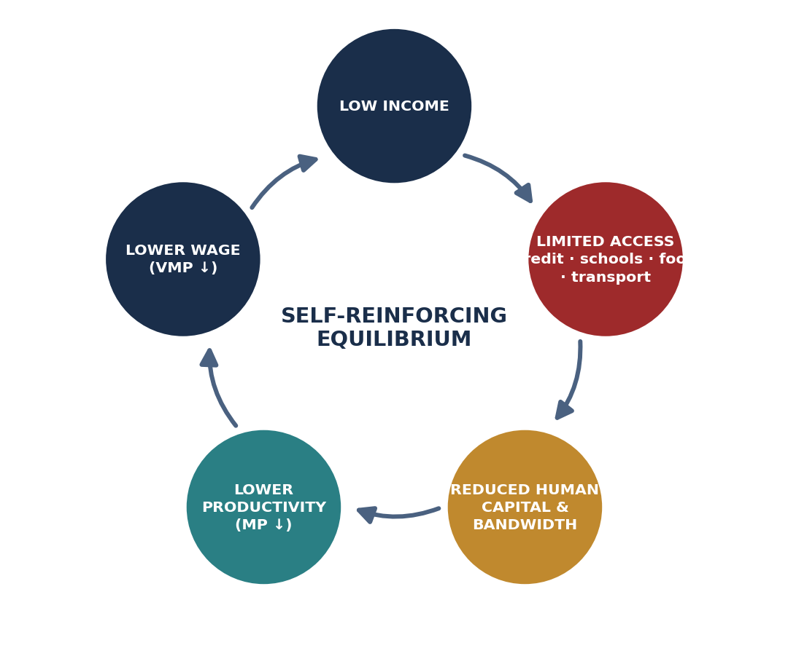
SCENARIO · MARCUS'S NEIGHBORHOOD, PHILADELPHIA
The Poverty Trap as a Feedback Loop
Marcus earns $15/hr in a monopsonistic labor market. His neighborhood has underfunded schools, few bank branches (a credit desert), high-cost payday lenders, and food deserts. EACH CONSTRAINT REINFORCES THE OTHERS.
POVERTY TRAP — formal definition
A self-reinforcing equilibrium in which the condition of being poor itself generates the mechanisms that keep a household or community poor. It is a STABLE equilibrium: small shocks are absorbed and the system returns to it.
THE CREDIT DESERT
Few bank branches means no relationship lending and no collateralized credit at market rates. Marcus's $15,000 food cart must be financed at payday rates or not at all — so a project with a positive return goes unbuilt (Module 2, Part 3).
THE BANDWIDTH TAX
Mullainathan & Shafir (2013): managing scarcity consumes the cognitive resources needed for exactly the long-horizon planning that would escape it. The trap taxes the faculty required to leave it.
INTERGENERATIONAL TRANSMISSION
Children in Marcus's neighborhood face LOWER intergenerational mobility than Ray's children — a smaller probability of ending in a higher income quintile than their parents. School funding tied to local property values makes the loop span generations: today's low income becomes tomorrow's low human capital, which becomes the next generation's low VMP.
INTRO TO MICROECONOMICS | PROF. VELAZQUEZ
MODULE 7: STRUCTURAL INEQUALITY & GAME THEORY PREVIEW

Slide 8
PART 1 · WORKSHEET ✦1
Three Institutional Changes That Break the Trap
THE QUESTION
A poverty trap is not simply a matter of individual choices — it is a self-reinforcing structural equilibrium. Identify three institutional changes that economic theory suggests would break the trap, and explain each mechanism using tools from Modules 1–6.
1
OPEN THE CREDIT MARKET
2
BREAK THE MONOPSONY
3
DE-LINK SCHOOLING FROM PROPERTY VALUES
A community development financial institution, credit union, or public loan guarantee.
MECHANISM (Module 2, Part 3): it lowers r, which moves the return-vs-rate test from FAIL to PASS for productive investments. The intertemporal budget constraint ROTATES outward about the endowment, enlarging the feasible set without transferring a cent of income.
A binding minimum wage, sectoral bargaining, a right to organize, or public transit that widens the commuting radius.
MECHANISM (Module 5 / Part 3 today): each raises the elasticity of labor supply facing the individual firm, or sets a floor above the monopsony wage. Uniquely, a minimum wage under monopsony can raise BOTH the wage AND employment — the opposite of the competitive prediction.
State-equalized school finance, universal pre-K, or means-tested tuition.
MECHANISM (Modules 5 and 6): human capital raises MP, which raises VMP = P × MP, which shifts labor DEMAND right — raising the wage rather than merely redistributing it. This is the only one of the three that moves the productivity term itself.
Each intervention changes the CONSTRAINT, not the preference.
That is the signature of a structural explanation. If the fix has to change what people want, you have written a story about character.
If it changes what people can reach, you have written a story about economics.
INTRO TO MICROECONOMICS | PROF. VELAZQUEZ
MODULE 7: STRUCTURAL INEQUALITY & GAME THEORY PREVIEW

Slide 9
02
The Lorenz Curve
& the Gini Coefficient
PART
OBJECTIVE Construct and interpret a Lorenz Curve; compute and evaluate the Gini Coefficient; understand what the statistic preserves and what it discards.
INTRO TO MICROECONOMICS | PROF. VELAZQUEZ
MODULE 7: STRUCTURAL INEQUALITY & GAME THEORY PREVIEW

Slide 10
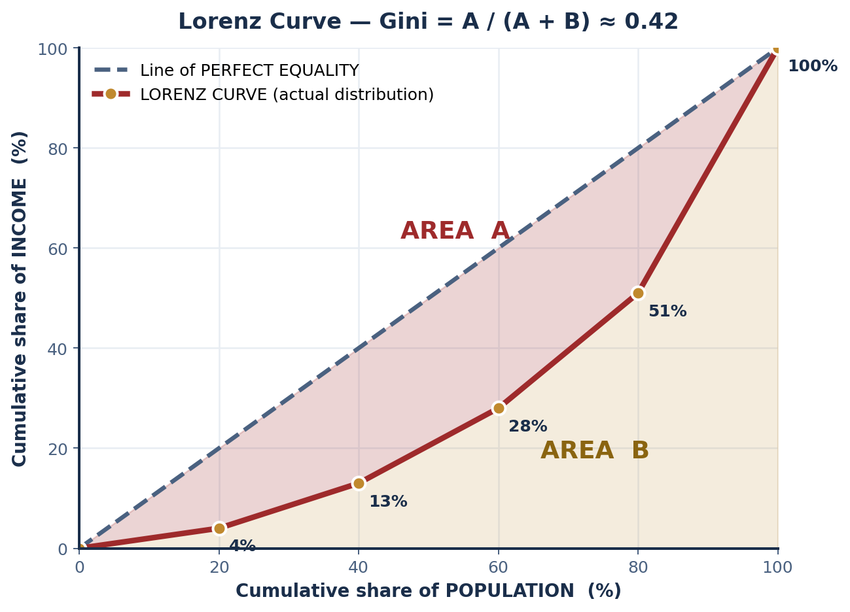
PART 2 · CONSTRUCTION
Building the Lorenz Curve from Quintile Data
INCOME QUINTILE | SHARE OF TOTAL INCOME (%) | CUMULATIVE INCOME SHARE (%) | PERFECTLY EQUAL (%) | SHORTFALL
Lowest 20% | 4 | 4 | 20 | −16
Second 20% | 9 | 13 | 40 | −27
Third 20% | 15 | 28 | 60 | −32
Fourth 20% | 23 | 51 | 80 | −29
Top 20% | 49 | 100 | 100 | 0
Gini = A / ( A + B )
≈ ( 0.5 − 0.292 ) / 0.5 = 0.42
READING THE ENDPOINTS
A Gini of 0 means PERFECT EQUALITY — every quintile holds exactly 20% and the Lorenz curve lies on the diagonal, so area A vanishes.
A Gini of 1 means PERFECT INEQUALITY — one household holds all income, the Lorenz curve runs along the bottom and right edges, and area B vanishes.
INTRO TO MICROECONOMICS | PROF. VELAZQUEZ
MODULE 7: STRUCTURAL INEQUALITY & GAME THEORY PREVIEW

Slide 11
PART 2 · WORKSHEET ✦2
What the Gini Preserves — and What It Discards
1
WHAT IT PRESERVES
2
WHAT IT DISCARDS
3
A CHANGE THE GINI WOULD MISS
· The OVERALL DISPERSION of income relative to a perfectly equal benchmark.
· Scale invariance — multiply every income by 10 and the Gini is unchanged, so it compares economies of different sizes.
· Population invariance — it does not depend on how many people are in the economy.
· The Pigou–Dalton principle: any transfer from a richer to a poorer household LOWERS the Gini.
· WHERE in the distribution the inequality sits. A Gini of 0.42 can come from a rich top or a destitute bottom, and the number cannot tell you which.
· ABSOLUTE living standards — a country can halve everyone's income and keep the same Gini.
· MOBILITY. The Gini is a snapshot; it says nothing about whether the same households occupy the bottom quintile next year.
· Wealth, as distinct from income.
Take $1,000 from the lowest quintile and give it to the second quintile, while simultaneously transferring an offsetting amount from the top quintile to the fourth.
The two moves can be calibrated so the Gini is UNCHANGED — yet the lived experience of the poorest households is materially worse. Lorenz curves that CROSS can even produce identical Ginis with entirely different bottom tails.
WHY THIS MATTERS METHODOLOGICALLY
The Gini is a SUMMARY STATISTIC: it compresses a rich, multi-dimensional distribution into one number so that comparison becomes possible. Every summary statistic buys comparability by discarding information. The economist's obligation is to know WHICH information was discarded, and to check whether the discarded part is the part the question is about.
ALTERNATIVE AND COMPLEMENTARY MEASURES
PALMA RATIO — top 10% share ÷ bottom 40% share; deliberately sensitive to the tails the Gini smooths. · P90/P10 RATIO — ninetieth percentile income divided by tenth. · POVERTY HEADCOUNT and POVERTY GAP — how many are below a line, and by how far. · INTERGENERATIONAL ELASTICITY — how much of a parent's income advantage passes to a child. Report the Gini WITH at least one of these, never alone.
INTRO TO MICROECONOMICS | PROF. VELAZQUEZ
MODULE 7: STRUCTURAL INEQUALITY & GAME THEORY PREVIEW

Slide 12
03
Monopsony, Wage Discrimination
& VMP Divergence
PART
OBJECTIVE Model monopsony wage suppression; analyze statistical discrimination; evaluate why wages diverge from VMP independently of worker productivity.
INTRO TO MICROECONOMICS | PROF. VELAZQUEZ
MODULE 7: STRUCTURAL INEQUALITY & GAME THEORY PREVIEW

Slide 13
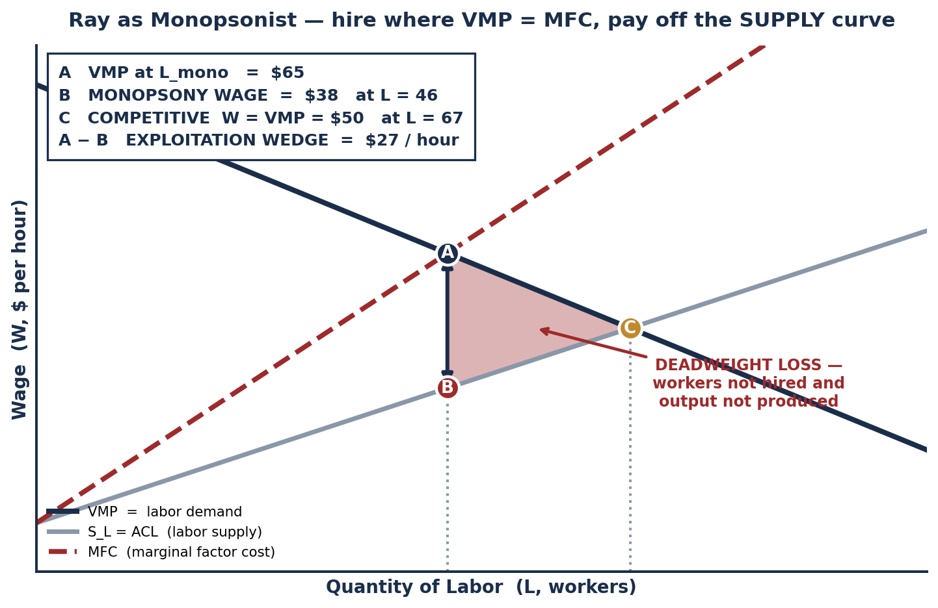
SCENARIO · RAY AS MONOPSONIST
Why the Monopsonist Pays Below VMP
THE SOURCE OF THE WEDGE
Ray is the dominant employer, so he faces an UPWARD-SLOPING labor supply curve rather than a horizontal one. To hire one more worker he must raise the wage — and he must pay that higher wage to EVERY worker already employed.
The cost of the marginal worker therefore exceeds that worker's wage. MFC > S_L, and the gap grows with L.
MFC = W + L · ( ΔW / ΔL )
The second term is what a price-taking firm does not pay: the raise owed to inframarginal workers.
THE TWO-STEP DECISION
STEP 1 — choose QUANTITY where VMP = MFC. This gives L_mono = 46, well below the competitive 67.
STEP 2 — read the WAGE off the SUPPLY curve at that quantity, not off VMP. This gives W = $38 against a VMP of $65.
THE DEADWEIGHT LOSS
Welfare is lost to the WORKERS WHO ARE NOT HIRED (their VMP exceeded their reservation wage, so a mutually beneficial trade went unmade) and to the OUTPUT NOT PRODUCED. As always, DWL measures trades that should have happened and did not.
INTRO TO MICROECONOMICS | PROF. VELAZQUEZ
MODULE 7: STRUCTURAL INEQUALITY & GAME THEORY PREVIEW

Slide 14
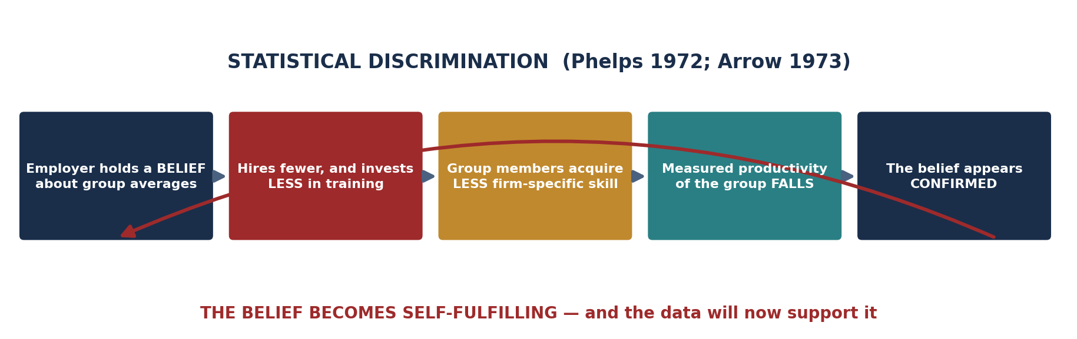
PART 3 · A SECOND ROUTE TO THE SAME RESULT
Statistical Discrimination
STATISTICAL DISCRIMINATION — formal definition
An employer uses GROUP-LEVEL AVERAGES to make an INDIVIDUAL hiring or wage decision, because individual productivity is costly or impossible to observe before hiring.
Phelps (1972) and Arrow (1973). Note that it requires NO animus: a purely profit-maximizing employer with imperfect information will do it.
WHY IT IS SELF-FULFILLING
If employers EXPECT Group A to be less productive, they invest LESS in training and offer fewer promotion tracks. Group A therefore accumulates LESS firm-specific human capital, and its measured productivity FALLS.
The belief creates the data that appears to confirm it. The equilibrium is stable even though the initial belief may have been false.
✦3 WHICH MECHANISM IS AMENABLE TO MARKET CORRECTION?
MONOPSONY: partly self-correcting only if entry is possible — a rival employer can profitably enter and bid workers away. Where entry is blocked by geography, licensing or scale, it persists indefinitely.
STATISTICAL DISCRIMINATION: NOT self-correcting, because the belief generates its own confirming evidence. Competition cannot punish a firm for acting on a belief the market has made true.
MINIMUM WAGE: under MONOPSONY a minimum wage set between W_mono and W_competitive raises the wage AND employment — the monopsonist's MFC becomes flat at the floor. Against STATISTICAL DISCRIMINATION it raises the floor but does nothing to the underlying belief or the training gap; that requires disclosure rules, structured hiring, or direct investment in the group's skill acquisition.
TASTE-BASED DISCRIMINATION — the contrast
Becker (1957): the employer has a PREFERENCE against the group and accepts lower profit to indulge it. Competition erodes this over time, because non-discriminating firms have lower costs and can undercut. Statistical discrimination has no such self-correction.
INTRO TO MICROECONOMICS | PROF. VELAZQUEZ
MODULE 7: STRUCTURAL INEQUALITY & GAME THEORY PREVIEW

Slide 15
04
Principal-Agent Problems:
Moral Hazard & Adverse Selection
PART
OBJECTIVE Define the principal-agent problem; explain moral hazard and adverse selection; identify the market distortion each produces.
INTRO TO MICROECONOMICS | PROF. VELAZQUEZ
MODULE 7: STRUCTURAL INEQUALITY & GAME THEORY PREVIEW

Slide 16
PART 4 · THE GENERAL STRUCTURE
The Principal-Agent Problem
A PRINCIPAL delegates to an AGENT who has DIFFERENT INFORMATION and DIFFERENT INCENTIVES.
The principal cannot costlessly observe either the agent's TYPE (before contracting) or the agent's ACTION (after contracting). Contracts are therefore INCOMPLETE, and the resulting allocation is inefficient.
CONTEXT | PRINCIPAL | AGENT | INFORMATION ASYMMETRY & THE PROBLEM
Marcus's employer | Ray | Marcus (worker) | Ray cannot observe effort continuously → MORAL HAZARD (hidden action). Ray responds with monitoring, piece rates, or efficiency wages — each of which is itself costly.
Health insurance market | Insurer | Policyholder | BOTH. Hidden TYPE before the contract: the sickest are most eager to buy (adverse selection). Hidden ACTION after it: the insured takes less care (moral hazard). Response: underwriting, deductibles, co-pays, mandates.
Used car market (Akerlof) | Buyer | Seller | The seller knows the car's quality and the buyer does not → ADVERSE SELECTION. Buyers offer only the average price; good cars withdraw; average quality falls; the price falls again. The market can UNRAVEL entirely.
Payday lending | Lender | Borrower | The lender cannot observe the borrower's true repayment probability → ADVERSE SELECTION drives rates up, which drives out the safest borrowers, which raises the average risk of those remaining, which drives rates up again.
MORAL HAZARD
ADVERSE SELECTION
A party takes on MORE RISK after being insured or contracted, because they do NOT bear the full cost of the outcome. The cost is shifted to the principal, so the agent's private optimum diverges from the social one.
HIDDEN ACTION — the problem arrives AFTER the contract is signed.
The party with MORE INFORMATION SELF-SELECTS into the market, leaving a pool of disproportionately BAD risks. The uninformed side prices for the average, which drives out the best, which worsens the average.
HIDDEN TYPE — the problem exists BEFORE the contract is signed.
INTRO TO MICROECONOMICS | PROF. VELAZQUEZ
MODULE 7: STRUCTURAL INEQUALITY & GAME THEORY PREVIEW

Slide 17
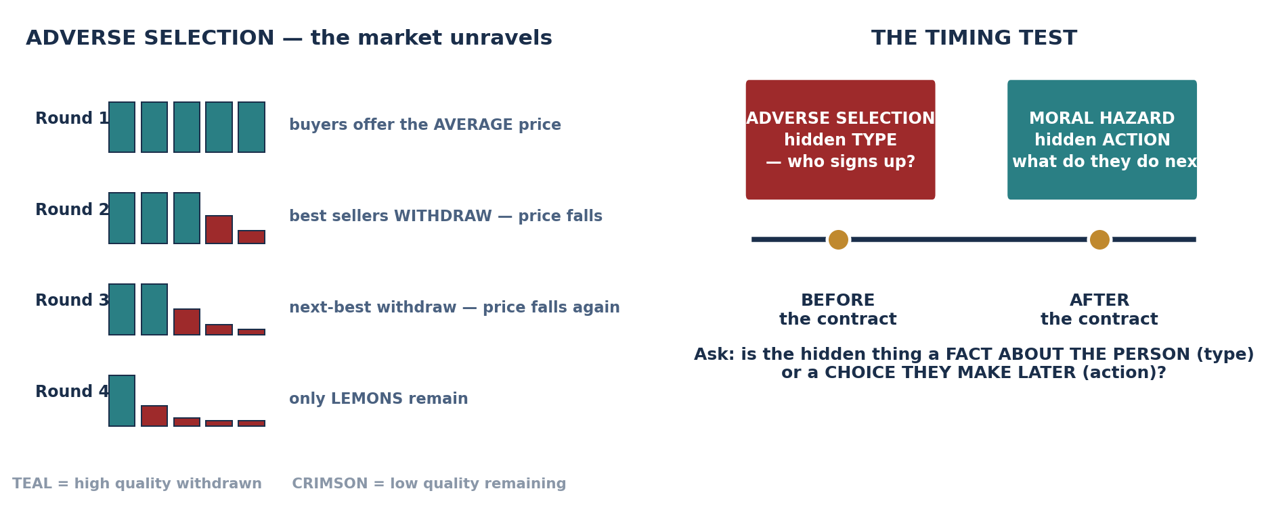
PART 4 · WORKSHEET ✦4
The Market for Lemons — Applied to Neighborhood Mortgages
1
HOW ADVERSE SELECTION RAISES THE RATE
2
WHY IT COMPOUNDS SPATIALLY
3
INSTITUTIONS THAT CORRECT IT
The lender cannot distinguish a reliable borrower from a risky one at acceptable cost, so it prices for the pool AVERAGE. Reliable borrowers find that rate unattractive and go elsewhere or don't borrow. The remaining pool is riskier, so the rate rises again. Credit becomes expensive precisely where it is most productive.
Historic redlining removed the LENDING HISTORY that would let a lender price individual risk. Thin data is itself the asymmetry. Absent branches, there is no relationship lending and no soft information — so the neighborhood is priced as an undifferentiated pool forever.
CREDIT REPORTING and alternative data (rent, utilities) — reduce the asymmetry directly. COMMUNITY BANKING and CDFIs — generate soft information a national lender cannot. GOVERNMENT GUARANTEES (FHA, SBA) — remove the risk the lender cannot price. Each works by supplying INFORMATION or absorbing the RESIDUAL RISK.
INTRO TO MICROECONOMICS | PROF. VELAZQUEZ
MODULE 7: STRUCTURAL INEQUALITY & GAME THEORY PREVIEW

Slide 18
SECTION II
Game Theory Preview · Asynchronous 📹
Part 5 · Payoff matrices, dominant strategies and the Nash equilibrium
Part 5 · The Prisoner's Dilemma and the collective action problem
Preview · Module 11 develops mixed strategies, repeated games and the folk theorem

Slide 19
05
Game Theory Preview:
Dominant Strategies & Collective Action
PART
OBJECTIVE Preview game theory: read a payoff matrix, identify dominant strategies and the Nash equilibrium, and explain why rational individual choices can produce collectively suboptimal outcomes.
INTRO TO MICROECONOMICS | PROF. VELAZQUEZ
MODULE 7: STRUCTURAL INEQUALITY & GAME THEORY PREVIEW

Slide 20
PART 5 · THE VOCABULARY
Reading a Game
PAYOFF MATRIX
DOMINANT STRATEGY
NASH EQUILIBRIUM
A table listing every combination of strategies and the payoff each player receives from it.
By convention, each cell reads (ROW PLAYER'S payoff, COLUMN PLAYER'S payoff). Read the first number down the rows and the second number across the columns.
A strategy that yields a HIGHER payoff than any alternative, REGARDLESS of what the other player does.
Test it by fixing the opponent's choice and comparing your own payoffs column by column. If one strategy wins every comparison, it strictly dominates.
A set of strategies such that NO PLAYER CAN IMPROVE their own payoff by unilaterally changing strategy.
Nash (1950) proved that every finite game has at least one — possibly in mixed strategies. It is the foundational solution concept of modern game theory.
THE RELATIONSHIP BETWEEN THE TWO CONCEPTS
If every player has a dominant strategy, the combination of dominant strategies IS the Nash equilibrium — and finding it is easy. The reverse does not hold: a Nash equilibrium can exist with no dominant strategies at all. Module 11 will need the general method; today the dominance shortcut suffices.
THE ASSUMPTIONS BEING MADE
WHY ECONOMICS NEEDS THIS
· Players are RATIONAL — each maximizes its own payoff.
· Payoffs are COMMON KNOWLEDGE — both players know the whole matrix.
· Choices are SIMULTANEOUS and made ONCE. Neither can observe the other's move first.
Module 11 relaxes the last assumption, and the answer changes completely.
Everything before Module 7 assumed agents face PRICES and respond to them. Game theory models agents who face EACH OTHER — where my best action depends on yours and yours on mine.
That is the right model for oligopoly (Module 11), for bargaining, for public goods, and for the climate commons (Module 6, Part 6).
INTRO TO MICROECONOMICS | PROF. VELAZQUEZ
MODULE 7: STRUCTURAL INEQUALITY & GAME THEORY PREVIEW

Slide 21
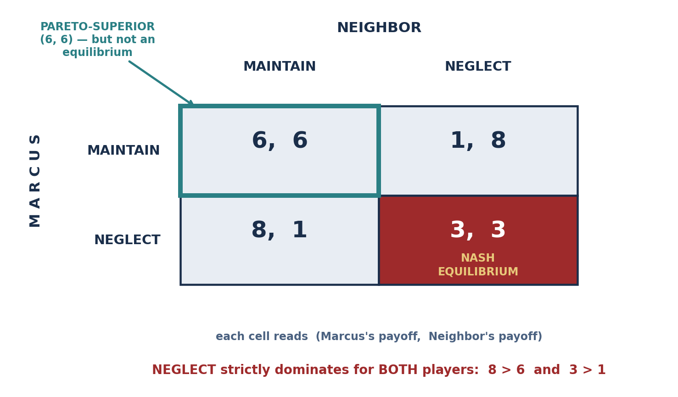
SCENARIO · MARCUS & RAY'S BLOCK
The Neighborhood Upgrading Game
Marcus and his neighbor can each choose to MAINTAIN or NEGLECT their property. The payoff structure creates a Prisoner's Dilemma: individual rationality leads to collective deterioration.
IF THE NEIGHBOR… | MARCUS: MAINTAIN | MARCUS: NEGLECT | MARCUS'S BEST REPLY
…MAINTAINS | 6 | 8 | NEGLECT (8 > 6)
…NEGLECTS | 1 | 3 | NEGLECT (3 > 1)
NEGLECT is Marcus's DOMINANT STRATEGY
It wins in every column. The game is symmetric, so the same is true for the neighbor.
THE THREE ANSWERS THE WORKSHEET WANTS
NASH EQUILIBRIUM: (NEGLECT, NEGLECT), yielding payoffs of (3, 3).
IS IT COLLECTIVELY OPTIMAL? NO. (MAINTAIN, MAINTAIN) yields (6, 6) — strictly better for BOTH players.
THE PARETO-SUPERIOR OUTCOME is therefore (MAINTAIN, MAINTAIN) — and it is unreachable, because each player has a private incentive to defect from it.
INTRO TO MICROECONOMICS | PROF. VELAZQUEZ
MODULE 7: STRUCTURAL INEQUALITY & GAME THEORY PREVIEW

Slide 22
PART 5 · WORKSHEET ✦5
Where This Structure Appears — and How to Escape It
THE QUESTION
The Prisoner's Dilemma shows that individually rational behavior can produce collectively irrational outcomes. Identify three real economic contexts — beyond this example — where this structure appears. Then identify one institutional mechanism that could sustain the cooperative outcome.
CONTEXT | WHY IT IS A PRISONER'S DILEMMA | THE COLLECTIVE COST
CLIMATE CHANGE — the atmospheric commons (Module 6, Part 6) | Every country is better off emitting whether or not others abate; abating alone bears the full cost and captures a fraction of the benefit. | Emissions far above the social optimum; the deadweight loss you drew as an externality triangle is the aggregate of every player's dominant strategy.
CARTEL PRICING — OPEC, or any oligopoly (Module 11) | Each member gains by cheating on the quota whether or not others comply. The collusive price is Pareto-superior FOR THE FIRMS but not an equilibrium. | Cartels are chronically unstable. Note that here the 'cooperative' outcome is bad for consumers — the structure is neutral about who benefits.
OVERFISHING and groundwater depletion | Each boat's catch is privately valuable and the stock depletion is shared. Restraint by one is captured by the others. | Stock collapse — the classic tragedy of the commons, which is a many-player Prisoner's Dilemma.
ADVERTISING and arms races between firms | If a rival advertises and you do not, you lose share; if neither advertises, both keep the share and save the cost. Advertising dominates. | Both firms spend heavily and market shares are unchanged. The spending is a pure transfer out of joint profit.
FREE RIDING on a PUBLIC GOOD — street lighting, a neighborhood association, a union | The good is NON-EXCLUDABLE, so each person's dominant strategy is to enjoy it without contributing. | The good is UNDER-PROVIDED or not provided at all. This is the COLLECTIVE ACTION PROBLEM in its purest form.
MECHANISMS THAT SUSTAIN COOPERATION — AND THE MODULE 11 PREVIEW
REPEATED INTERACTION with a long shadow of the future: if the game is played indefinitely, strategies like tit-for-tat can make cooperation an equilibrium. This is the FOLK THEOREM, and it is the single most important result in Module 11. · BINDING CONTRACTS AND ENFORCEMENT — change the payoffs so that defection is punished. · OSTROM'S DESIGN PRINCIPLES (1990): locally-devised rules, graduated sanctions, cheap conflict resolution and monitoring by the users themselves — documented commons that do NOT end in tragedy. · CHANGING THE PAYOFF MATRIX DIRECTLY: a tax on defection, a subsidy for cooperation, or assigning property rights (Coase, Module 12).
INTRO TO MICROECONOMICS | PROF. VELAZQUEZ
MODULE 7: STRUCTURAL INEQUALITY & GAME THEORY PREVIEW

Slide 23
YOU TRY
Module 7 — Independent Practice
Complete all five Parts of the Module 7 Worksheet, including the poverty-trap loop diagram, the Lorenz curve and the monopsony diagram.
Compute the Gini by the trapezoid method and show your working — the cumulative column is the part most students get wrong.
Draw the monopsony diagram with S_L, MFC and VMP all labeled, and mark W_competitive, W_mono, L_competitive, L_mono and the DWL region.
Answer reflection questions ✦1 through ✦5 in complete sentences. Every one asks you to convert a diagram into an argument about institutions.
HOMEWORK RULE OF THUMB: above 80% → move on. Below 80% → retry once or twice. Consistently below 80% → office hours, immediately.
ASYNC
INTRO TO MICROECONOMICS | PROF. VELAZQUEZ

Slide 24
MODULE 7
What You Should Be Able to Do
 | LEARNING OUTCOME
Part 1 | Define a poverty trap as a self-reinforcing equilibrium and draw the feedback loop with at least four nodes; explain the credit-desert and bandwidth-tax mechanisms using Module 2 tools; explain intergenerational transmission; propose three institutional interventions and name the mechanism of each.
Part 2 | Build a cumulative income column from quintile shares; plot a Lorenz curve against the diagonal; compute the Gini by the area method and interpret 0 and 1; state three things the Gini preserves and three it discards; name an alternative measure and say what it adds.
Part 3 | Explain why a monopsonist's MFC lies above the labor supply curve, and write the formula; execute the two-step decision (quantity from VMP = MFC, wage from S_L); identify the exploitation wedge and the DWL; define statistical discrimination and explain why it is self-fulfilling; contrast it with taste-based discrimination; predict the effect of a minimum wage under monopsony.
Part 4 | State the principal-agent structure; distinguish moral hazard (hidden action, after) from adverse selection (hidden type, before) using the timing test; trace the unravelling logic of the market for lemons; apply it to a neighborhood credit market and name three corrective institutions.
Part 5 | Read a payoff matrix in (row, column) convention; identify a dominant strategy by column-by-column comparison; locate the Nash equilibrium and verify that no unilateral deviation improves either payoff; explain why the Nash outcome can be Pareto-inferior; name three real contexts with this structure and one mechanism that sustains cooperation.
NEXT
MODULE 8 — STRUCTURAL INEQUALITY EXTENSIONS. We take the four mechanisms built here and apply them to wealth, race, gender, geography and the climate crisis — Climate Arc, Part 2.
INTRO TO MICROECONOMICS | PROF. VELAZQUEZ
MODULE 7: STRUCTURAL INEQUALITY & GAME THEORY PREVIEW

Slide 25
MODULE 7
References
Akerlof, G. A. (1970). The market for lemons: Quality uncertainty and the market mechanism. Quarterly Journal of Economics, 84(3), 488–500.
Arrow, K. J. (1973). The theory of discrimination. In Discrimination in Labor Markets. Princeton University Press.
Becker, G. S. (1957). The economics of discrimination. University of Chicago Press.
Bowles, S., & Gintis, H. (2002). The inheritance of inequality. Journal of Economic Perspectives, 16(3), 3–30.
Chetty, R., Hendren, N., Kline, P., & Saez, E. (2014). Where is the land of opportunity? Quarterly Journal of Economics, 129(4), 1553–1623.
Gini, C. (1912). Variabilità e mutabilità. Bologna: C. Cuppini.
Lorenz, M. O. (1905). Methods of measuring the concentration of wealth. Publications of the American Statistical Association, 9(70), 209–219.
Manning, A. (2003). Monopsony in motion: Imperfect competition in labor markets. Princeton University Press.
Mullainathan, S., & Shafir, E. (2013). Scarcity: Why having too little means so much. Times Books.
Nash, J. F. (1950). Equilibrium points in n-person games. PNAS, 36(1), 48–49.
Ostrom, E. (1990). Governing the commons. Cambridge University Press.
Phelps, E. S. (1972). The statistical theory of racism and sexism. American Economic Review, 62(4), 659–661.
INTRO TO MICROECONOMICS | PROF. VELAZQUEZ
MODULE 7: STRUCTURAL INEQUALITY & GAME THEORY PREVIEW

